Slide 1
The PIC microcontroller
PIC18F4520: Timers and Counters

Slide 2
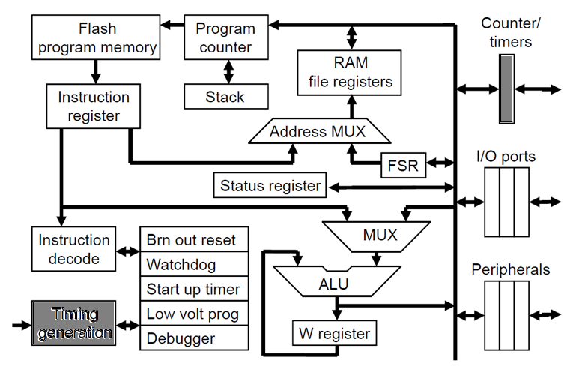
PIC18F: Controller Architecture

Slide 3
PIC18F: Notational convention
WREG
W Register
FREG
File Register (any register location from GPR Bank 0 / SFR)
[X]
Contents of register X
[WREG] = 0x02 ↔ WREG’s contents become 0x02
[0x20] = 0x34 ↔ RAM File Register 0x20 content becomes 0x34
[X] = [Y] ↔ Contents of Y are copied into X
Number systems
Decimal | d’10’
Hexadecimal | h’4A’ or 0x4A
Binary | b’1000 0010’

Slide 4
timers

Slide 5
Electronics: Need for ‘time’
Computing world runs on ‘time’
Synchronization
Clocks
Triggers
Setup / hold times to talk to sensors / devices
Need for highly accurate sense of time
Precise, reproducible
Independent - hardware-module driven
Resilient
Controllers have timers for this purpose

Slide 6
Electronics: Concept of a ‘Timer’
Independent clock-driven hardware
Software (code)
Configuration
Control: Start, stop
Keeps ‘ticking’; ‘overflow’ event tied to time interval
Timer Components
Configuration registers
Timer registers
Keep count, accumulate ‘ticks’
8-bit, 16-bit, …
Clock
Control speed of ticking

Slide 7
Electronics: Timer working principle
Let’s consider an 8-bit timer
Timer register is initialized
Often, to 0x00
Timer is ‘started’
Starts ‘ticking’, every tick increments timer register
Timer register reaches maximum (0xFF)
Called ‘overflow’ – event is used to derive time
Timer register gets reset to 0x00
Timer starts ‘ticking’ and counting again
For 16-bit timer
Timer register initialized to 0x0000
Overflows when timer register reaches 0xFFFF
8-bit
0x00
0xFF
16-bit
0x0000
0xFFFF

Slide 8
PIC18F: Timer details
PIC18F4520 has 4 Timers
Timer0, Timer1, Timer2, Timer3
8-bit / 16-bit / both!
Dual role – as timer or as counter
Study of Timer0 (other timers are ‘similar’)
8-bit / 16-bit – Configurable in software
Registers
Configuration, status and control – T0CON
Timer register – TMR0H:TMR0L
Usable as a counter (T0CLKI)

Slide 9
PIC18F: TIMER0 Configuration: T0CON
TMR0ON
T08BIT
T0CS
T0SE
PSA
T0PS2
T0PS1
T0PS0
TMR0ON: Timer0 on/off control bit
1: On, 0: Off
T08BIT: Timer0 8-bit/16-bit mode control
1: 8-bit, 0: 16-bit
T0CS: Timer0 clock source select
1: Transition on T0CKI, 0: Use internal clock CLK0
T0SE: Timer0 edge select
1: High-to-low, 0: Low-to-high
PSA: Timer0 pre-scaler enable
1: Disable, 0: Enable
T0PS<2:0>: Timer0 pre-scaler ratio select bits
000: 1:2
001: 1:4
010: 1:8
011: 1:16
…
111: 1:256

Slide 10
PIC18F: Timer0 Resources
Timer registers – depending on 8-bit / 16-bit
TMR0H:TMR0L
Configuration and control register
T0CON
Overflow indicator flag
TMR0IF (part of INTCON register)
TMR0’s Interrupt Flag
Goes from 0 to 1 on an overflow event
Should be reset to 0 before using Timer0, and after an overflow!
TMR0IE (part of INTCON register)
If 1, enables TMR0 interrupts
TMR0 interrupt will be generated on an overflow event
8-bit
0x00
0xFF
0x00
TMR0IF
0x01

Slide 11
PIC18F: Timer0 – usage method
Initialization / configuration
Fill T0CON and configure the timer (but don’t start it yet!)
Fill proper values in TMR0, TMRL
Reset TMR0IF to 0
Start Timer0 by setting TMR0ON to 1 (T0CON)
Check for TMR0 overflow
Option #1
Monitor TMR0IF (INTCON) changing to 1, continuously
Called ‘polling’ method
Option #2
Enable TMR0’s interrupt (set TMR0IE to 1)
Handle TMR0’s interrupt in an ISR
Stop the timer once you are done using it!

Slide 12

PIC18F: Timer0 – Real-world problem
Generate a 2 kHz square-wave on RB4 for 10MHz crystal clock
Main code:
Make RB4 an output pin
Configure Timer0 (fill in T0CON)
16-bit mode, Internal clock source, ratio 1:1 (PSA disabled)
Clear TMR0IF
Timer_Loop
Fill TMR0:TMR0L with a proper value (say T0VAL)
Call TMR_DLY function
Toggle RB4
TMR_DLY function
Start Timer0 (TMR0ON)
Monitor TMR0IF going to 1
Once it goes 1
Stop Timer0
Clear TMR0IF
Return
t_{OFF}
t_{ON}
T
$$f=\frac{1}{T}=2 kHz$$
$$T=\frac{1}{f}=500 μsec$$
$$TON=TOFF=250 μsec$$

Slide 13
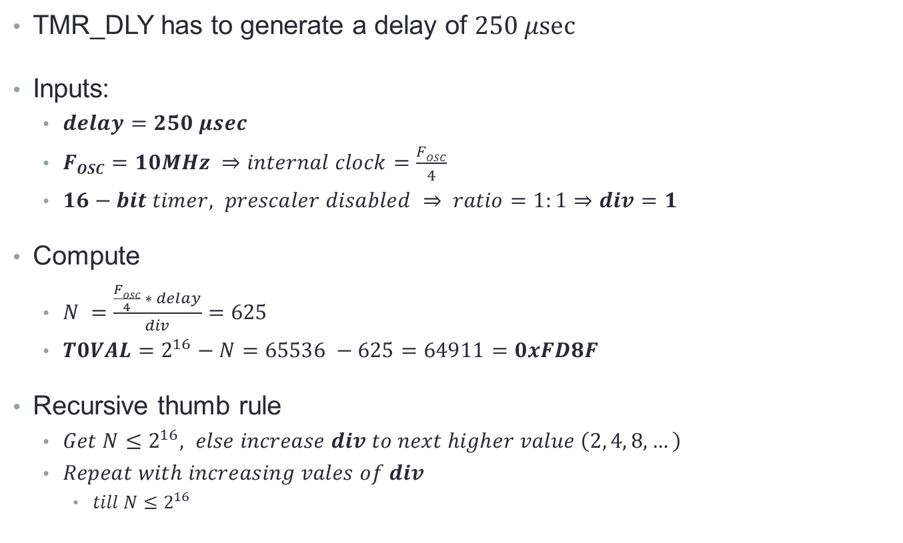
PIC18F: Timer0 – Calculations
TMR_DLY has to generate a delay of $250 μsec$
Inputs:
$delay=250 μsec$
$FOSC=10MHz ⇒internal clock=\frac{FOSC}{4}$
$16−bit timer, prescaler disabled ⇒ ratio=1:1⇒div=1$
Compute
$N =\frac{\frac{FOSC}{4} ∗ delay}{div}=625$
$T0VAL=2^{16}−N=65536 −625=64911=0xFD8F$
Recursive thumb rule
$Get N≤2^{16}, else increase div to next higher value \left(2, 4, 8, …\right)$
$Repeat with increasing vales of div$
$till N≤2^{16}$

Slide 14
PIC18F: Timer0 – Code
Main code
TMR_DLY
T0VAL_L EQU 0x8F
T0VAL_H EQU 0xFD
BCF TRISB, 4
MOVLW 0x08 ; b’00001000’
MOVWF T0CON
LOOP1 MOVLW T0VAL_L
MOVWF TMR0L
MOVLW T0VAL_H
MOVWF TMR0H
BCF INTCON, TMR0IF
CALL TMR_DLY
BTG PORTB, 4
BRA LOOP1
TMR_DLY BSF T0CON, TMR0ON
LOOP2 BTFSS INTCON, TMR0IF
BRA LOOP2
BCF T0CON, TMR0ON
BCF INTCON, TMR0IF
RETURN
TMR0ON
T08BIT
T0CS
T0SE
PSA
T0PS2
T0PS1
T0PS0

Slide 15
counters

Slide 16
PIC18F: Timer0 in counter mode
TMR0ON
T08BIT
T0CS
T0SE
PSA
T0PS2
T0PS1
T0PS0
T0CS: Timer0 clock source select
1: Transition on T0CKI, 0: Use internal clock CLK0
Steps:
Put T0CS to 1, reset TMR0H:TMR0L to 0!
Start Timer0
Accept external clock / event input from T0CKI pin
On every ‘event’, TMR0H:TMR0L increment

Slide 17
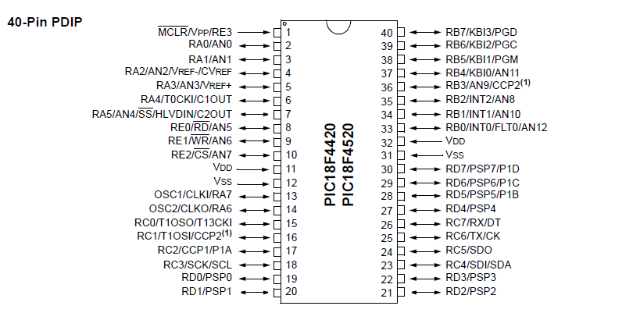
PIC18F: Input for Timer0 as counter
External clock here

Slide 18
PIC18F: Timers, Counters Summary
Concept of timers, counters
Advantages of timer / counter module
Hardware-driven
CPU independent
Leaves CPU free to do something else
Specially if timer interrupts are enabled
CPU can now do multi-tasking!
More accurate and resilient
Can generate interrupts
No need to actively poll / monitor
PIC18F timers
Timer0 as a timer or counter

Slide 19
Thank you!

